Slide 1

Cooking with AWS and Splunk
Module 1: Getting Started with AWS
Kam Amir | Splunk Cloud Architect

Slide 2
Splunk on AWS
Running Splunk on AWS and the partnership with Amazon Web Services

Slide 3


Splunk Runs On & With AWS
Delivery Models
Apps and Integrations
SaaS on AWS
DIY with Amazon EC2
Enterprise on AWS
Cloud Services Apps
Splunk App for AWS, ServiceNow, Salesforce, etc.
100% Uptime SLA
SOC2 Type II Certified
Runs on AWS
Splunk Core + Enterprise Security & ITSI available
Insights for AWS
AWS Specific Integrations
CloudTrail, CloudWatch/Logs, Config/Rules, Inspector, Kinesis, S3, VPC Flow Logs, Billing, SQS, SNS
Deploy with AWS Quick Start!
Notes:
~2:00 minutes
Enumerate AWS specific offerings and solutions. Briefly describe each one:
Splunk cloud – SaaS application built on AWS, 100% uptime SLA and it’s SOC 2 certified
Splunk paid AMI coming in July , currently you can get a BYOL in marketplace AMI.
Splunk Insights for AWS
Enterprise Security: This is positioned as a “premium service”
ITSI:
Splunk App for AWS:

Slide 4
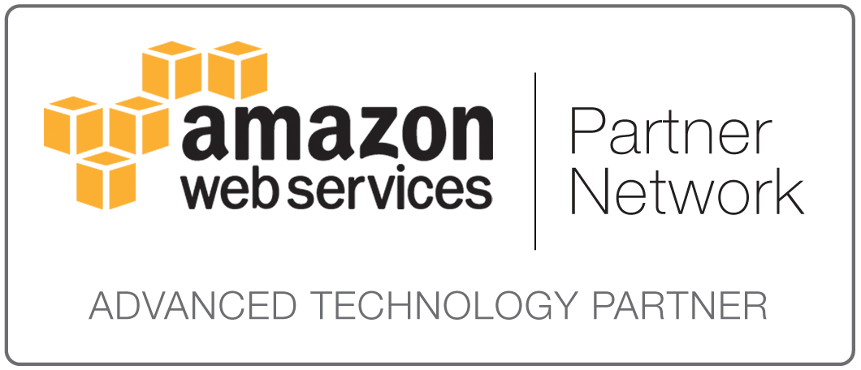
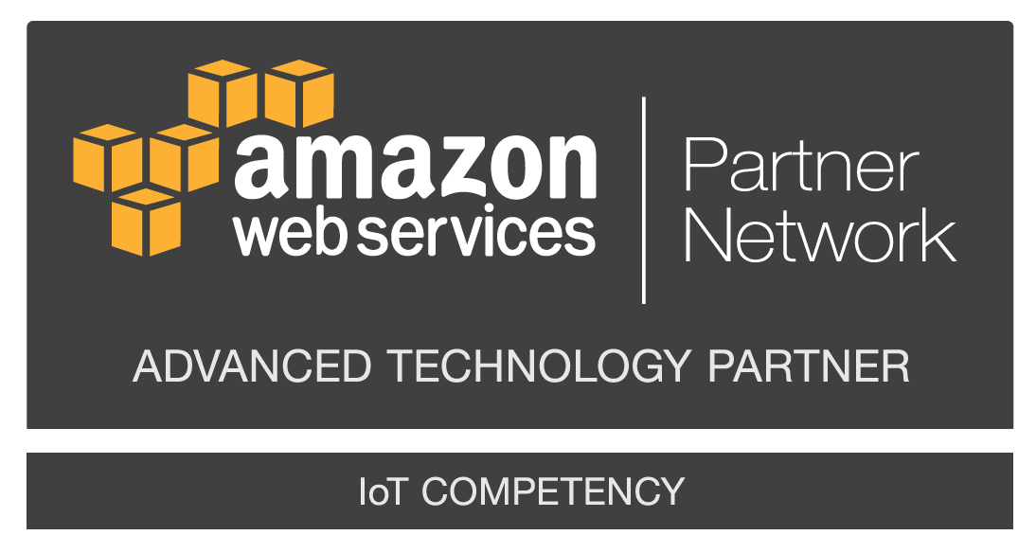
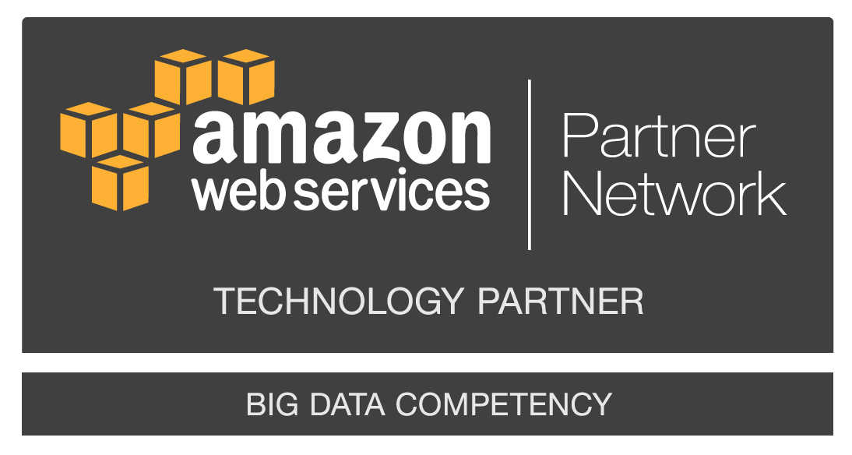

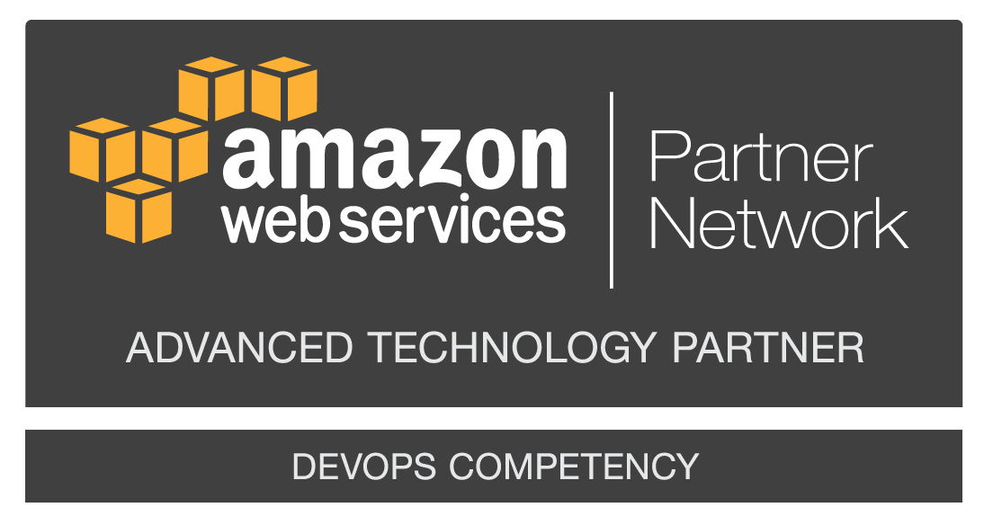
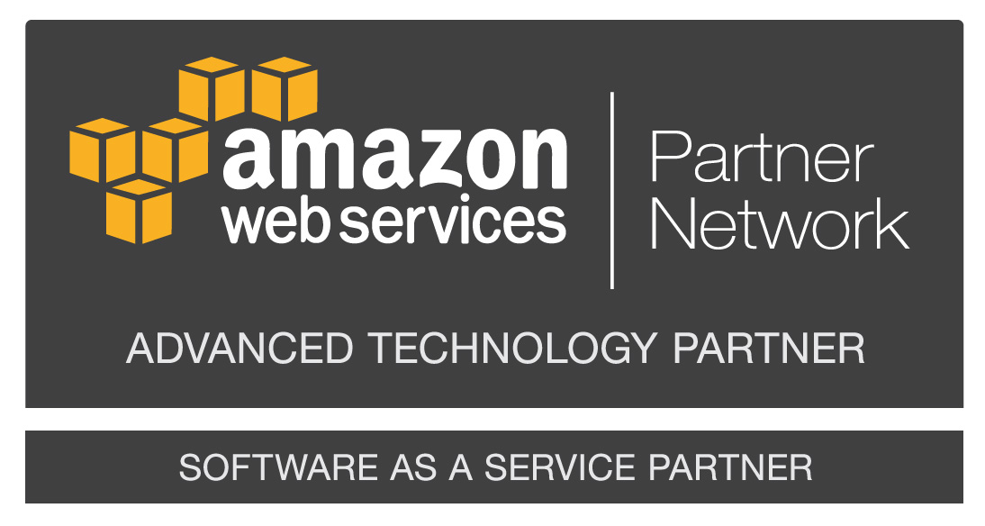

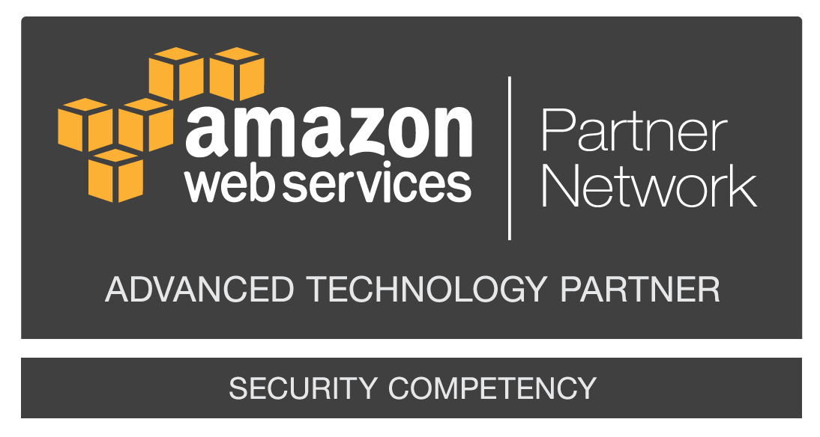
Splunk’s AWS Credentials
AWS Advanced Technology Partner
AWS Big Data Competency
AWS Security Competency
AWS DevOps Competency
AWS Government Competency
AWS Education Competency
AWS IoT Competency
AWS MSP Technology Provider
AWS Marketplace Partner
AWS Security by Design Program Partner
1st partner with published Blueprints for AWS Lambda
1st partner to pass SaaS extension for Well Architected framework
Notes:
Splunk has a number of AWS competencies and is an active member of the Amazon Partner Network.

Slide 5
What is AWS?

Slide 6

AWS 101
Notes:
For those of you who are new to Cloud, just remember cloud is simply using someone else’s computer. There are significant benefits to doing this which we will cover during this presentation.

Slide 7
AWS 101 - Terms
Amazon Web Services Terms
EC2 – Elastic Compute Cloud (Version 2.0)
S3 – Simple Storage Service
SNS – Simple Notification Service
SQS – Simple Queueing Service
VPC – Virtual Private Cloud
EBS – Elastic Block Storage
ELB – Elastic Load Balancer
Lambda – On Demand Compute
AWS Cloudtrail – API Calls
AWS Cloudwatch - Metrics
AWS Config - CMDB
Kinesis - Kafka
CloudFormation - Automation
Notes:
Here is a list of general AWS terms that we will be referencing for this workshop. We will explain all of these terms and how they are relevant to the Splunk App for AWS.

Slide 8
AWS translated to legacy data center world
Server (EC2)
EC2 = Servers in a rack
EBS = SAN (Network Storage)
VPC = Storage + Compute + Network
SQS or SNS = Message Queue (MQ)
S3 = Object Storage (Ceph)
Lambda = OnDemand Ephemeral compute
Glacier = Tape Backup
Kinesis = Kafka
Compute + Storage + Network
(VPC)
SAN (EBS)
NAS (S3)
Tape (Glacier)
MQ (SNS / SQWS)
Notes:
In order to help some people understand the concepts of AWS, here is a comparison of legacy data center terminology matched with it’s AWS equivalent.

Slide 9
AWS Storage on Splunk Explained
Server Attached Storage (Ephemeral)*
EBS (SSD/Magnetic)
S3
Glacier
* Ephemeral storage while fast can be lost if the
server is stopped or destroyed*
EC2 SAS - Hot / Warm
Fastest
EBS - Cold Buckets (Magnetic)
Fast
S3 - Frozen Buckets
Slow
Glacier - S3 Archive
Slowest
Notes:
Storage on AWS can be broken down into four groups. The first is server attached storage (SAS) which is storage directly attached to the server instance. This is the fastest storage of the group but has one major flaw in that it is ephemeral. If your server goes down, then you will potentially lose all your data. This tier of storage is ideal for Hot/Warm clustered data.
EBS (Elastic Block Storage) is data which can be attached over the network to your instance. This is similar to SAN storage. The main drawback for EBS is cost since you need to purchase provisioned IO to guarantee storage performance. The slower EBS volumes can be used to store Cold buckets in Splunk.
S3 (Simple Storage Service) is similar to HDFS or Object storage like Ceph. Splunk can archive it’s Frozen data to this tier of storage.
Glacier is very slow, and only used to archive data. It is tape backup and has a long SLA to retrieve and restore the data.

Slide 10
AWS Services

Slide 11

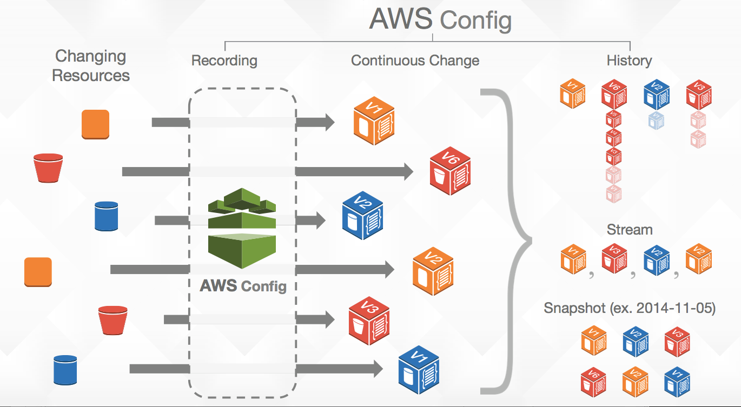
AWS Config
AWS Config
Configuration snapshots
Historical configuration data
Change notifications from the AWS Config service
AWS Config Rules
Compliance details
Compliance summary
Evaluation status of your AWS Config Rules
Notes:
AWS Config is a fully managed service that provides you with an AWS resource inventory, configuration history, and configuration change notifications to enable security and governance. Config Rules enables you to create rules that automatically check the configuration of AWS resources recorded by AWS Config.
Common use cases:
Discovery
Change Management
Audit and Compliance
Troubleshooting
Security and Incident Analysis
With AWS Config, you can discover existing and deleted AWS resources, determine your overall compliance against rules, and dive into configuration details of a resource at any point in time. These capabilities enable compliance auditing, security analysis, resource change tracking, and troubleshooting.

Slide 12



AWS Config Rules
Set a desired configuration
Evaluated against resource configuration
Unencrypted
EBS volume
created
Evaluate against
Config rules
Flag as
Non-compliant
Notes:
A Config Rule represents desired configurations for a resource and is evaluated against configuration changes on the relevant resources, as recoded by AWS Config. The results of evaluating a rule against the configuration of a resource are available on a dashboard. Using Config Rules, you can assess your overall compliance and risk status from a configuration perspective, view compliance trends over time and pinpoint which configuration change caused a resource to drift out of compliance with a rule.

Slide 13
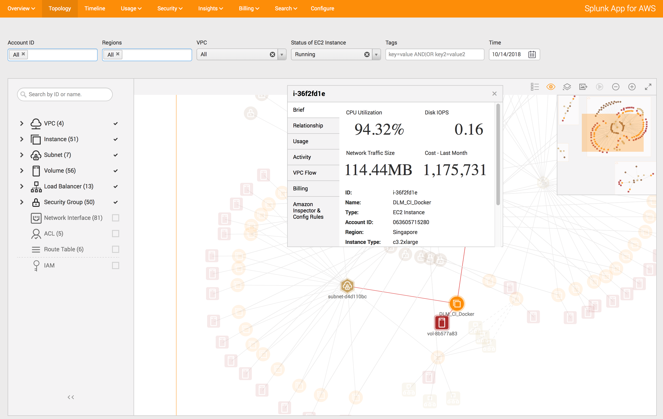
AWS Config
Populates the Following Dashboards in the Splunk App for AWS:
Overview
Topology
Security Groups
Resource Activity
Timeline
Config Rules
Notes:
The Splunk App for AWS leverages AWS Config in the following Dashboards / Reports:
Overview
Topology
Security Groups
Resource Activity
Timeline
Config Rules

Slide 14

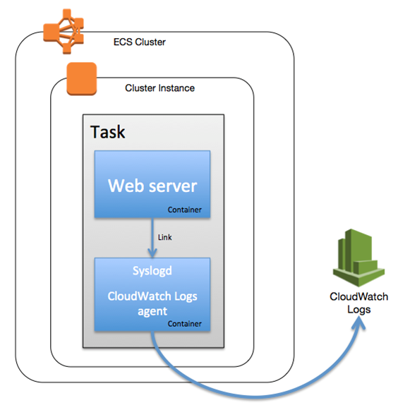
AWS CloudWatch
Performance and billing metrics from the AWS CloudWatch service.
CloudWatch Logs, which are a different input, can also be collected by Splunk.
Monitor Amazon EC2 & other service
Collect and track metrics
Collect and monitor logs
Set alarms
Set custom metrics
Notes:
Cloudwatch provides monitoring for AWS resources and the customer applications running on the Amazon infrastructure.
Customers use Cloudwatch to monitor EC2 instances, EBS volumes, ELBs, RDS, VPC Flow logs, and other metrics
Cloudwatch functions through AWS API’s which are available through the AWS SDK
Cloudwatch enables the monitoring of Ec2 instances as well as other AWS resources (Monitor metrics on Amazon DynamoDB tables, Amazon EBS volumes, Amazon RDS DB instances, Amazon Elastic MapReduce job flows, Elastic Load Balancers, Amazon SQS queues, Amazon SNS topics, and more for no additional charge. No additional software needs to be installed.)
Custom metrics can be generated for custom applications via a simple API request which are then monitored by Cloudwatch. Alarms can be set when certain thresholds are met, and users can be either be notified of these alerts, or have AWS react dynamically with auto scaling the infrastructure.

Slide 15
AWS CloudWatch
Two CloudWatch components, with different functions
CloudWatch Logs
CloudWatch (events)
Collect logs from CloudWatch agents or AWS services where UF’s cannot be used.
Popular examples include CloudWatch Agents (OS Logs), VPCFLow Logs, ECS, WAF Logs
Can be collected using Lambda functions and Kinesis Firehose to HEC
Performance and billing metrics from the AWS CloudWatch service.
Monitor Amazon EC2 & other service
Requires HF to collect metrics from CloudWatch
Notes:
Cloudwatch provides monitoring for AWS resources and the customer applications running on the Amazon infrastructure.
Customers use Cloudwatch to monitor EC2 instances, EBS volumes, ELBs, RDS, VPC Flow logs, and other metrics
Cloudwatch functions through AWS API’s which are available through the AWS SDK
Cloudwatch enables the monitoring of Ec2 instances as well as other AWS resources (Monitor metrics on Amazon DynamoDB tables, Amazon EBS volumes, Amazon RDS DB instances, Amazon Elastic MapReduce job flows, Elastic Load Balancers, Amazon SQS queues, Amazon SNS topics, and more for no additional charge. No additional software needs to be installed.)
Custom metrics can be generated for custom applications via a simple API request which are then monitored by Cloudwatch. Alarms can be set when certain thresholds are met, and users can be either be notified of these alerts, or have AWS react dynamically with auto scaling the infrastructure.

Slide 16
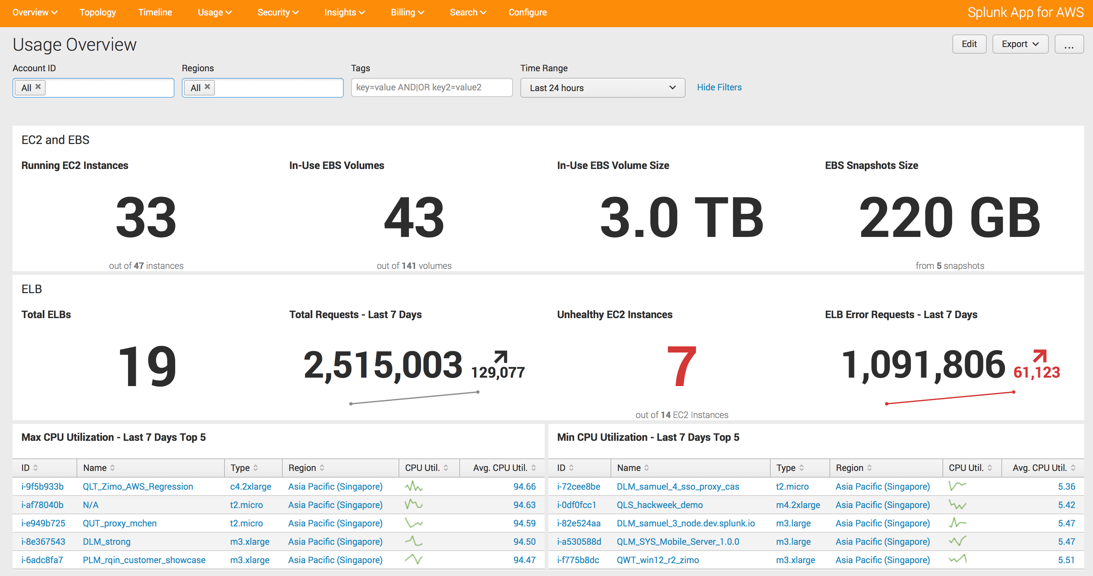
AWS CloudWatch
Populates the Following Dashboards in the Splunk App for AWS:
Overview
Topology
Usage Overview
EC2 Instances
EBS Volumes
ELB Instances
Relational Database Service
Current Month Estimated Billing
Insights Overview /
EC2 / ELB / EBS Insights
Billing Anomaly Insights
Lambda
Notes:
The Splunk App for AWS leverages the AWS CloudWatch Service to populate the following Dashboards / Reports:
Overview
Topology
Usage Overview
EC2 Instances
EBS Volumes
ELB Instances
Relational Database Service
Current Month Estimated Billing
Insights Overview /
EC2 / ELB / EBS Insights
Billing Anomaly Insights
Lambda

Slide 17
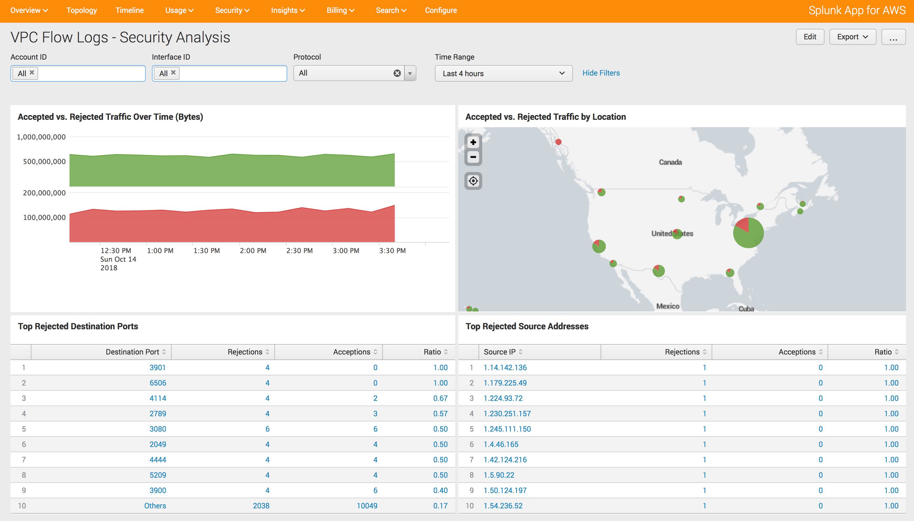
AWS CloudWatch Logs
Data:
CloudWatch Logs service
Including VPC flow logs.
Allow you to capture IP traffic flow data for the network interfaces in your resources.
Dashboards:
Topology
VPC Flow Logs – Traffic Analysis
VPC Flow Logs – Security
Analysis
Notes:
CloudWatch Logs are used by the Splunk App for AWS to populate the following Dashboards and Reports:
Topology
VPC Flow Logs – Traffic Analysis
VPC Flow Logs – Security
Analysis

Slide 18

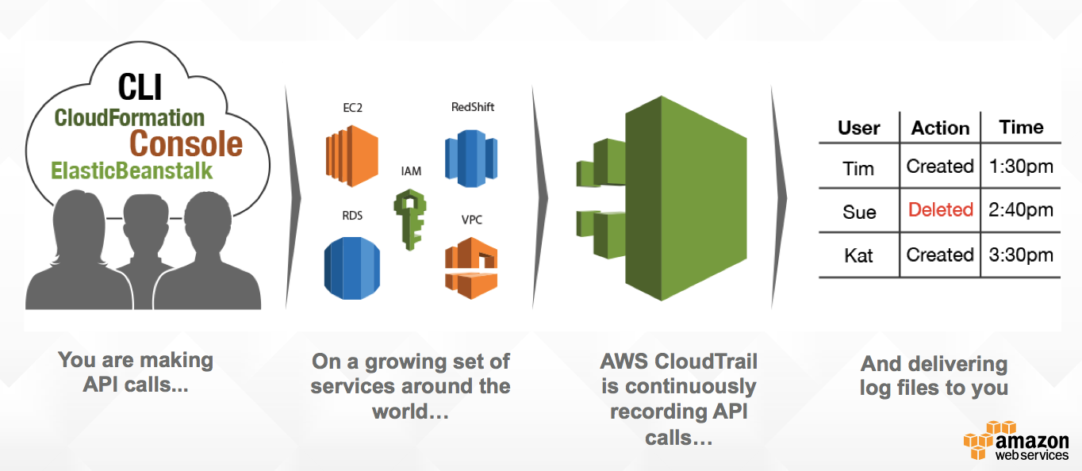
AWS CloudTrail
Notes:
AWS CloudTrail is a web service that records AWS API calls for your account and delivers log files to you.
The recorded information includes the identity of the API caller, the time of the API call, the source IP address of the API caller, the request parameters, and the response elements returned by the AWS service.
The AWS API call history produced by CloudTrail enables security analysis, resource change tracking, and compliance auditing.
With CloudTrail, you can get a history of AWS API calls for your account, including API calls made via the AWS Management Console, AWS SDKs, command line tools, and higher-level AWS services (such as AWS CloudFormation).

Slide 19
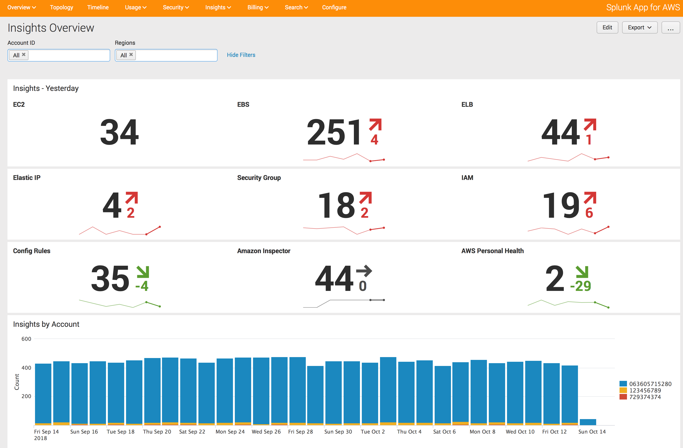
AWS CloudTrail
Records AWS API calls for your account and delivers log files to you
Populates Dashboards:
Overview
Topology
Security Overview
IAM Activity
VPC Activity
Security Groups
Key Pairs Activity
Network ACLs
User Activity
Insights Overview
Security Anomaly Insights
Timeline
Notes:
The Splunk App for AWS uses the CloudTrail data to populate the following Dashboards / Reports:
Overview
Topology
Security Overview
IAM Activity
VPC Activity
Security Groups
Key Pairs Activity
Network ACLs
User Activity
Insights Overview
Security Anomaly Insights
Timeline

Slide 20

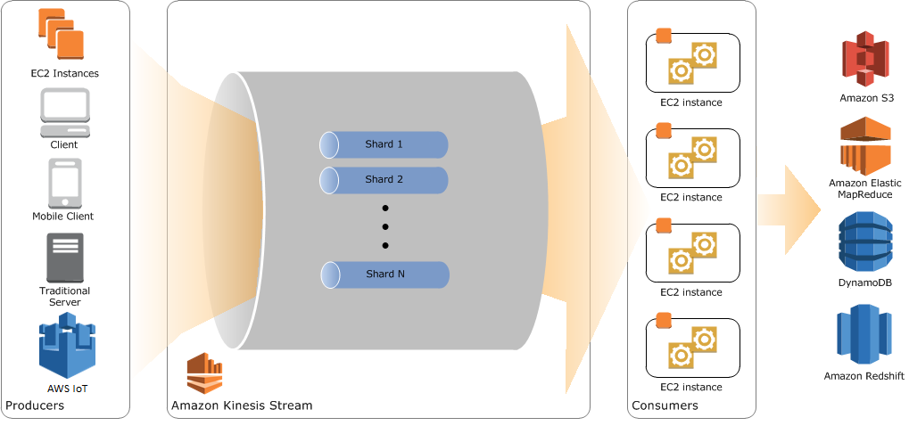

AWS Kinesis (Streaming)
Notes:
Real-time streaming data pipe, similar to Kafkta in the open source world. Splunk can listen to Kinesis streams and process and analyze the data in Splunk.

Slide 21











Kinesis Firehose With Splunk Delivery
Native delivery endpoints for Firehose
Ingest
Transform
Deliver
Amazon Kinesis Agent
Amazon S3
Amazon Kinesis Streams
Amazon Redshift
Amazon CloudWatch Logs
Amazon Elasticsearch
Amazon CloudWatch Events
AWS IoT

Slide 22

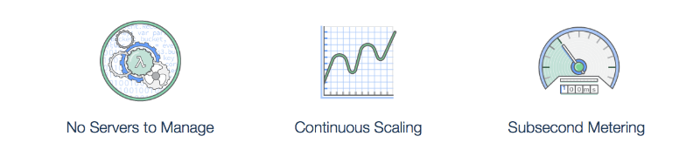
AWS Lambda Functions
AWS Lambda supports code written in:
Node.js (JavaScript)
Python
Java (Java 8 compatible)
C# (.NET Core)
Your code can include existing libraries, even native ones.
Notes:
On-demand compute that executes code based on blueprints. Splunk leverages Lambda functions to send data into HEC from CloudWatch Logs like VPCFlow Logs.

Slide 23
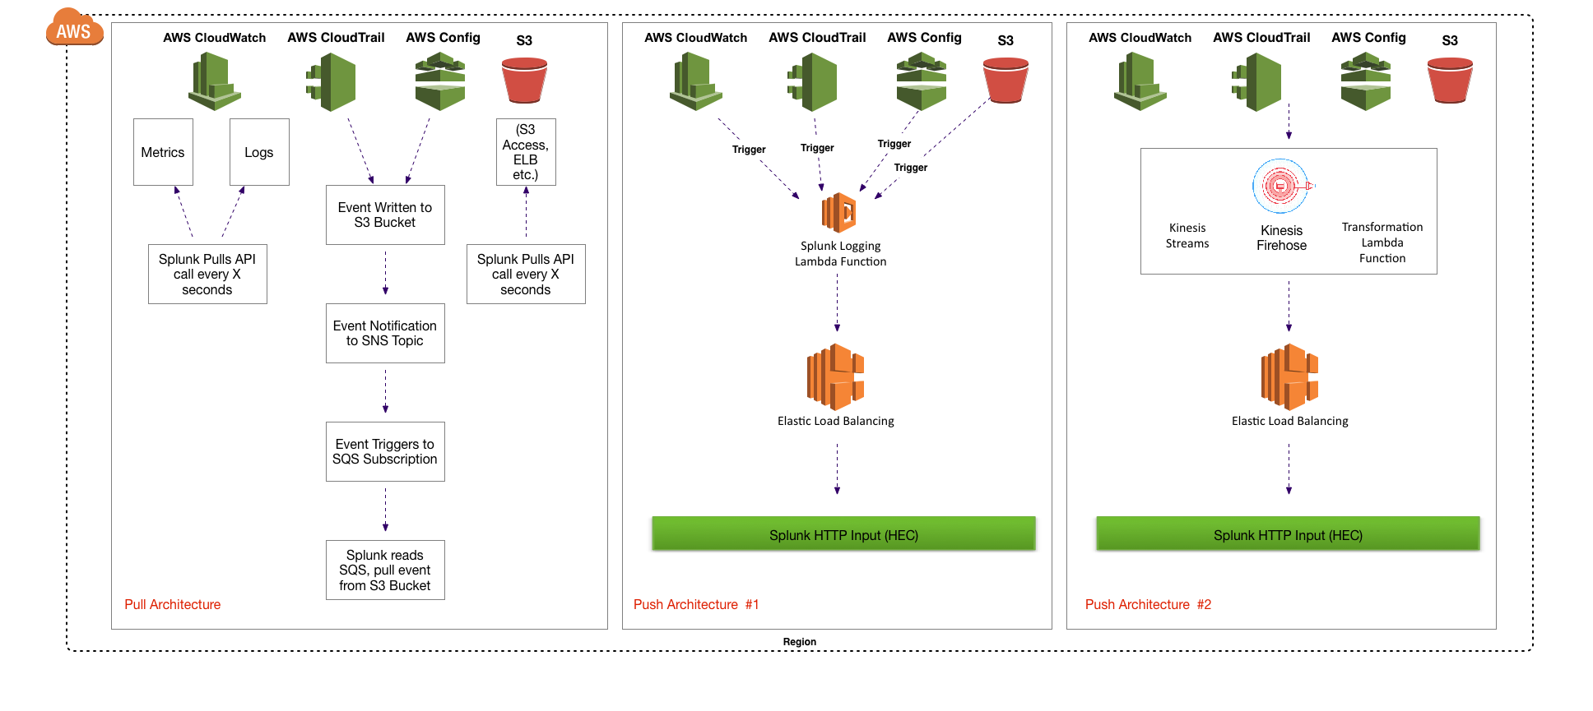
Integrating AWS with Splunk
Notes:
The current state for collecting AWS data and sending it into Splunk can be broken down into two paths. The Splunk Add-on for AWS leverages the AWS python SDK (boto) to collect the data from the AWS services. The higher volume data feeds such as CloudWatch Logs like VPCFlow Logs or Kinesis Streams would be better collected using the Splunk HTTP Event Collector (HEC).
The input mechanism used by Splunk is constantly evolving, please stay tuned for future changes to this architecture.

Slide 24
Continue to Module 2: Configure AWS

